Slide 1
Best Buy for business online experience plan
PROJECT ASSESSMENT
AUGUST, 2016

Slide 2
Executive summary
Multi-Phase Approach
Best Buy For Business catalogue to be integrated to BBY.ca
Onboard BBFB as a Marketplace seller
Create a BBFB Store-Within-a Store experience on BBY.ca
Work with Marketing/SEM and SEO teams to develop proper strategies to drive traffic to BBFB SWS

Slide 3
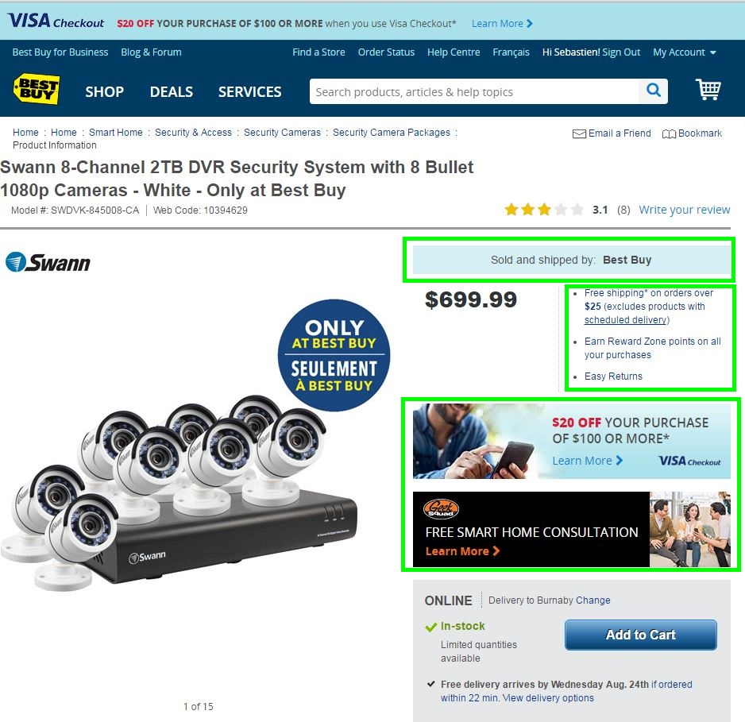
BBFB catalogue integration to BBY.ca
Set up BBFB as a Marketplace seller
Seamless catalogue and order management
Clear communication to customers that items
are for businesses
- Deconstructing the Customer Journey
Product Detail Page
Solr Search Engine
Product Listing Page
Search Results
Solr Sku Collections
Relevant Categories
Homepage Presence

Slide 4
BBfB- a store within a store
Leverage the Brand Store capability to create the BBFB SWS
A Shopping Experience
By Product
By Industry
By Size
Services Integration
Business Support
Geek Squad
Other
Great example: http://www.samsung.com/us/business/

Slide 5
Key elements required
Value Propositions
Why BBFB?
BBFB Promise?
Ease of Shopping
Policies
Return
Shipping
Business Support
List of services offered by BBFB to all business sizes
Online Resources/ Site Monetization Opportunities
Buying Guides
Showcases
Blogs/Videos
Client Support
Call Centre
Email
Click-to-Chat
Help Topics/FAQ

Slide 6
Next steps
Finalize detailed plan of online experience optimization - Ecomm
Present proposal and get approval from leadership and stakeholders - BBFB
Business Case?
Request support of resources in each key areas:
Content
Content Presentation Analysts
SEO
Taxonomy
Presentation Hierarchy
User Experience/GUI
Ecommerce Retail Team
Marketing
Creative
Digital Marketing
Best Buy For Business

